Slide 1
GCBASIC
PIC18FxxQ35chip Family
Part 15 – Millis and Interrupts

Slide 2

GCBASIC
PIC18FxxQ35chip Family
Part 15 – Millis and Interrupts

Slide 3
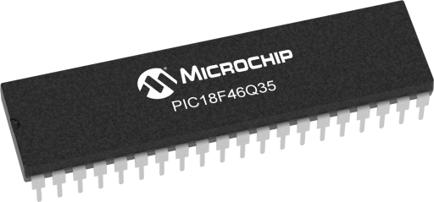
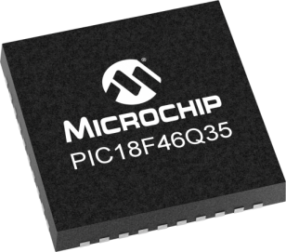
GCBASIC
Like and subscribe!

Slide 4
PIC18FxxQ35
PIC18FxxQ35 is a high performance PIC18
  Digital and analog peripherals for flexible embedded control
  10-bit ADC for accurate analog signal conversion
  Multiple communication interfaces including UART (serial), I²C, and SPI
  PWM modules with CCP and 16-bit resolution for precise timing and motor control
  Configurable Logic Cells (CLCs) for custom hardware-level logic without external components
  Integrated op amps for onboard analog signal conditioning and amplification
The PIC18FxxQ35 offers 28, 40 and 44-pin products in small footprint packages to support customers in a wide variety of applications.

Slide 5
Videos...
Install the hardware and make the board work – make LEDs work
Make four LEDs flash in a sequence
Set the LEDs to represent the value of ADC
Sequence the LEDs with a delay using the value of ADC
Using an input to set the state of the LEDs
Using the reset switch
Using the switch, ADC – make the LEDs flash in a sequence with reverse
Using the serial to display values
Using the timer0 overflow, 8bit timer, 16bit timer to flash the LEDs
Using EEProm – showing values on the serial terminal, and more constants insights
Using I2C with serial to discover I2C devices
Using an I2C GCLD display
Using a SPI GCLD display
Using PWM, many ways, to dim the LEDS
Using Millis and Interrupts
Using storage within the chip – Progmem, SAF memory, EEPROM and DATA blocks
Using CLC
The GCBASIC tool chain
Assembly , alternatives assemblers and MPLAB-X
Summary

Slide 6
GCBASIC Compiler
GCBASIC Compiler
GCBASIC is an Open Source compiler for PIC, AVR and LGT microcontrollers
GCBASIC now supports the 18FxxQ35 chip family
GCBASIC now supports 1400+ microcontrollers

Slide 7
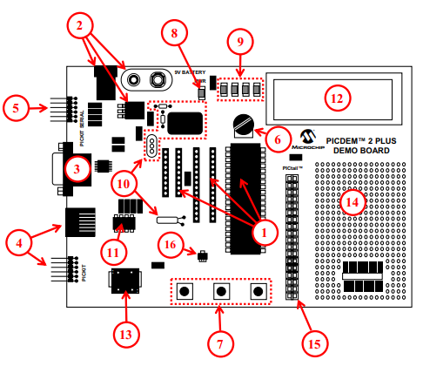
PICDEM 2 Plus Demonstration
Board
1. 18-, 28- and 40-pin DIP sockets
(although three sockets are provided, only one device may be used at a time)
2. On-board, +5V regulator for direct input from 9V, 100 mA AC/DC wall adapter or 9V battery, or hooks for a +5V, 100 mA regulated DC supply
3. RS-232 socket and associated hardware for direct connection to an RS-232 interface
4. Programmer/debugger connectivity supporting MPLAB® ICD 3, MPLAB REAL ICE and PICkitPlus
5. PICkit Serial Connector for analysis of serial communications peripherals such as SPI or I2C™
6. 5 k pot for devices with analog inputs
7. Three push button switches for external stimulus and Reset
8. Power-on indicator LED
9. Four LEDs connected to PORTB
10. On-board external oscillators including:
a) Unpopulated DIP socket for canned crystal oscillator (Y2)
b) RC oscillator circuit (R4, C3)
c) Unpopulated holes for crystal connection (Y1)
d) 32.768 kHz crystal for Timer1 clock operation (Y3)
11. 32K x 8 Serial EEPROM
12. LCD display
13. Piezo buzzer
14. Prototype area for user hardware
15. Expansion Header for PICtail™ daughter card connectivity or user access to MCU pins
16. Microchip TC74 thermal sensor
Plus SPI GLCD
3A

Slide 8
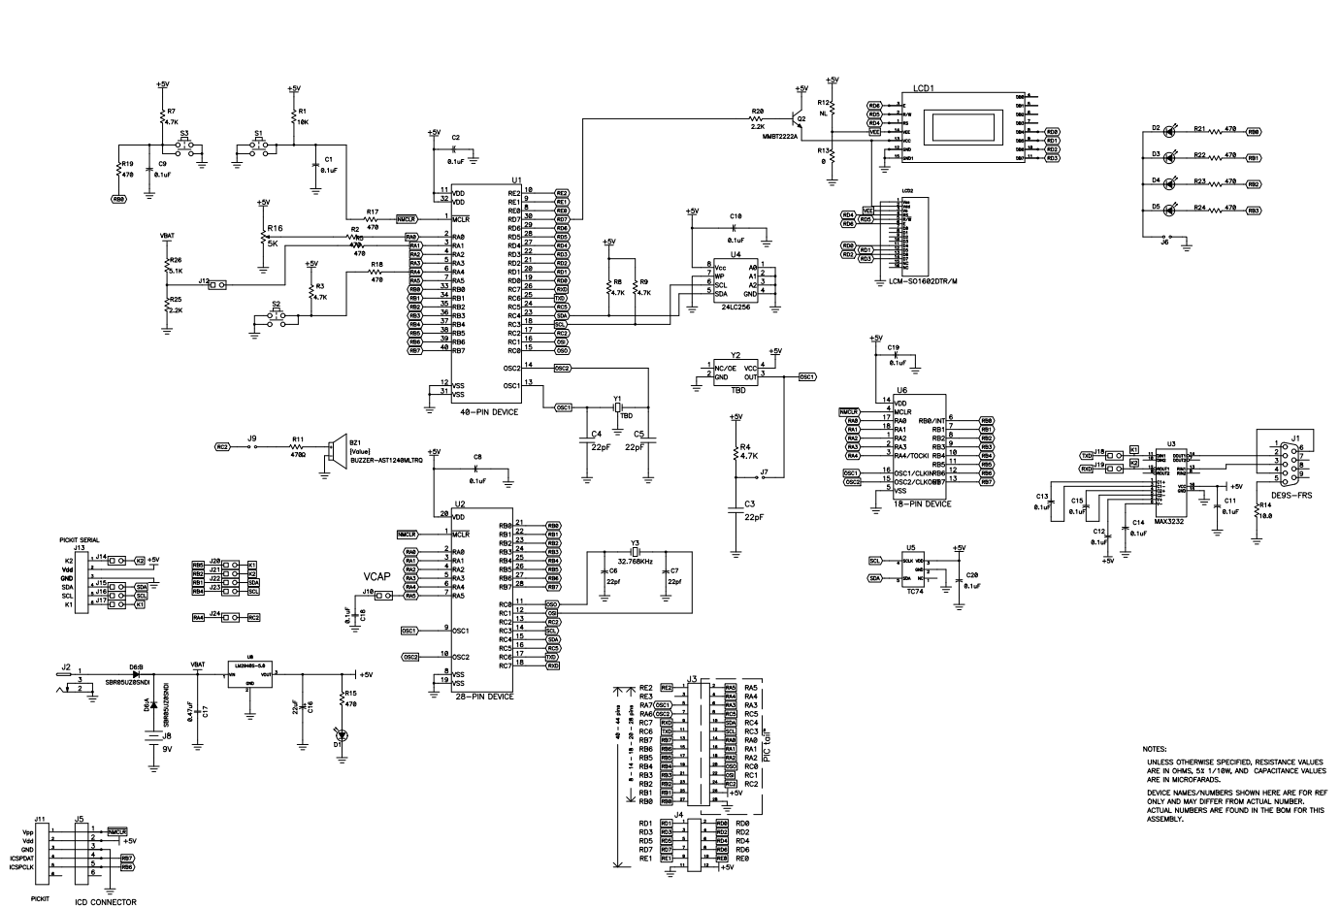
PICDEM 2 Plus Demonstration
Board

Slide 9
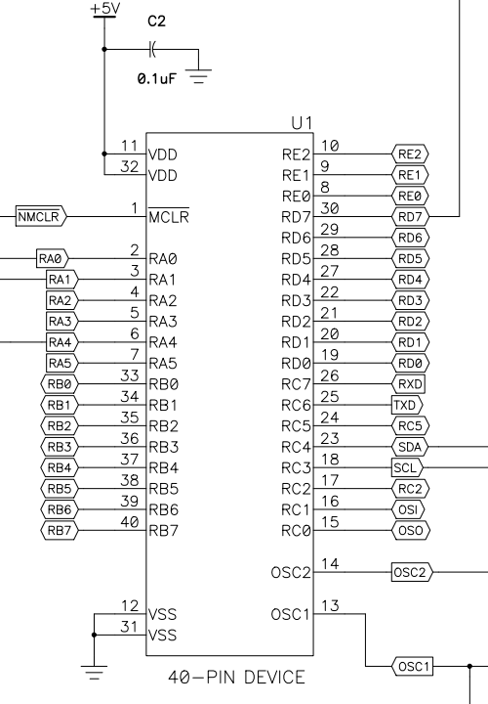
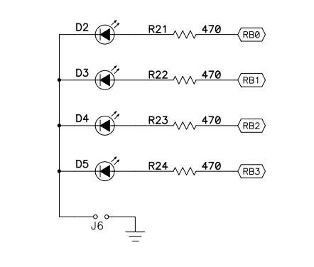
PICDEM 2 Plus Demonstration
Board
VDDIO2

Slide 10
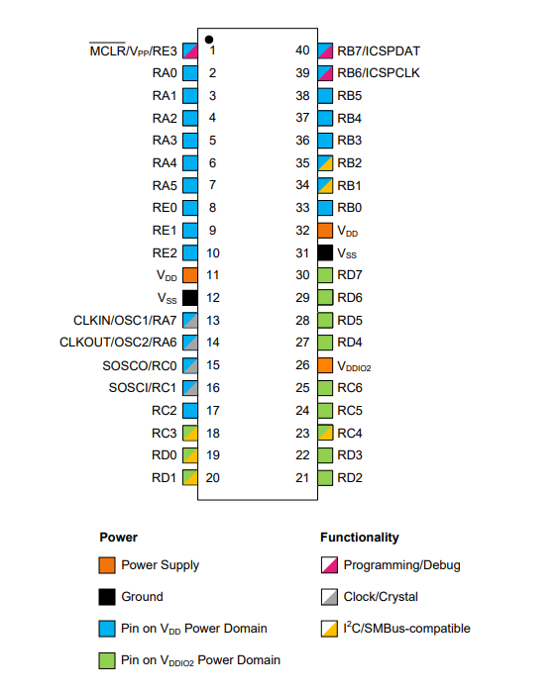
VDDIO2 Domain Power
Think
No VDDIO2 power – no domain I/O!

Slide 11
Millis()
Returns milliseconds since program start/reset
  like Arduino's timing for GCBASIC
Key Benefit
  Non-blocking delays for multitasking
  no code halts
  unlike DelayMS
Return Type
  32-bit unsigned long (0–4.3B ms)
  1ms precision via timers
Time Limit
  ~49.7 days before overflow
  Resets on power cycle.

Slide 12
Lab
Walk the example

Slide 13
Principles of Interrupts
Interrupts are events that alter the normal execution flow of a program to respond to external or internal events.
Advantages
    Immediate response to critical events
    Efficient use of the microcontroller's resources
Types of Interrupts
    External Interrupts: Triggered by events on external pins (RB0/INT0, RB1/INT1, etc.)
    Timer Interrupts: Triggered by timer overflows or matches
    Peripheral Interrupts: Triggered by events from peripherals (USART, ADC, etc.)
    Software Interrupts: Triggered by software instructions
Key Registers
    INTCON: Controls global interrupt enable and individual interrupt flags
    PIE1, PIE2: Peripheral Interrupt Enable registers
    PIR1, PIR2: Peripheral Interrupt Request (flag) registers
Interrupt Service Routine (ISR)
    Special function that executes when an interrupt occurs
    Must be as short and efficient as possible to avoid delaying other operations

Slide 14
Interrupts…
DMA4DestinationCountInterrupt:DMA4DCNTIE,DMA4DCNTIF
DMA4OverrunInterrupt:DMA4ORIE,DMA4ORIF
DMA4SourceCountInterrupt:DMA4SCNTIE,DMA4SCNTIF
ExtInt0:INT0IE,INT0IF
ExtInt1:INT1IE,INT1IF
ExtInt2:INT2IE,INT2IF
I2C1ErrorInterrupt:I2C1EIE,I2C1EIF
I2C1Interrupt:I2C1IE,I2C1IF
I2C1ReceiveInterrupt:I2C1RXIE,I2C1RXIF
I2C1TransmitInterrupt:I2C1TXIE,I2C1TXIF
LogicCell1Event:CLC1IE,CLC1IF
LogicCell2Event:CLC2IE,CLC2IF
LogicCell3Event:CLC3IE,CLC3IF
LogicCell4Event:CLC4IE,CLC4IF
LogicCell5Event:CLC5IE,CLC5IF
LogicCell6Event:CLC6IE,CLC6IF
LogicCell7Event:CLC7IE,CLC7IF
LogicCell8Event:CLC8IE,CLC8IF
NVMComplete:NVMIE,NVMIF
NumericOscOverflow:NCO1IE,NCO1IF
OscillatorFail:OSFIE,OSFIF
PORTABChange:IOCIE,IOCIF
PWM1MatchEvent:PWM1IE,PWM1IF
PWM2MatchEvent:PWM2IE,PWM2IF
PWM2PeriodEvent:PWM2PIE,PWM2PIF
PWMPeriodEvent:PWM1PIE,PWM1PIF
PortChange:IOCIE,IOCIF
SPIInterrupt:SPI1IE,SPI1IF
SPIReceiveInterrupt:SPI1RXIE,SPI1RXIF
SPITransmitInterrupt:SPI1TXIE,SPI1TXIF
ScanComplete:SCANIE,SCANIF
SignalRoutingPortIOC:IOCSRIE,IOCSRIF
SoftwareInterrupt:SWIE,SWIF
Timer0Overflow:TMR0IE,TMR0IF
Timer1Gate:TMR1GIE,TMR1GIF
For specific details of the interrupts see the microcontroller datasheet
The first parameter is the GCBASIC identifier used in user code to expose the specific interrupt
16bitUniversalTimerAInterrupt:TU16AIE,TU16AIF
16bitUniversalTimerBInterrupt:TU16BIE,TU16BIF
ADCReady:ADIE,ADIF
ADThreshold:ADTIE,ADTIF
ActiveClockTuning:ACTIE,ACTIF
CCP1:CCP1IE,CCP1IF
CLB0:CLB0IE,CLB0IF
CLB1:CLB1IE,CLB1IF
CLB2:CLB2IE,CLB2IF
CLB3:CLB3IE,CLB3IF
CRCComplete:CRCIE,CRCIF
CWG1ShutDown:CWG1IE,CWG1IF
ClockSwitchComplete:CSWIE,CSWIF
Comp1Change:C1IE,C1IF
Comp2Change:C2IE,C2IF
DMA1AbortInterrupt:DMA1AIE,DMA1AIF
DMA1DestinationCountInterrupt:DMA1DCNTIE,DMA1DCNTIF
DMA1OverrunInterrupt:DMA1ORIE,DMA1ORIF
DMA1SourceCountInterrupt:DMA1SCNTIE,DMA1SCNTIF
DMA2AbortInterrupt:DMA2AIE,DMA2AIF
DMA2DestinationCountInterrupt:DMA2DCNTIE,DMA2DCNTIF
DMA2OverrunInterrupt:DMA2ORIE,DMA2ORIF
DMA2SourceCountInterrupt:DMA2SCNTIE,DMA2SCNTIF
DMA3AbortInterrupt:DMA3AIE,DMA3AIF
DMA3DestinationCountInterrupt:DMA3DCNTIE,DMA3DCNTIF
DMA3OverrunInterrupt:DMA3ORIE,DMA3ORIF
DMA3SourceCountInterrupt:DMA3SCNTIE,DMA3SCNTIF
DMA4AbortInterrupt:DMA4AIE,DMA4AIF
Timer1Overflow:TMR1IE,TMR1IF
Timer2Match:TMR2IE,TMR2IF
Timer3Gate:TMR3GIE,TMR3GIF
Timer3Overflow:TMR3IE,TMR3IF
Timer4Match:TMR4IE,TMR4IF
UART1FramingErrorInterrupt:U1EIE,U1EIF
UART1Interrupt:U1IE,U1IF
UART1ReceiveInterrupt:U1RXIE,U1RXIF
UART1TransmitInterrupt:U1TXIE,U1TXIF
UART2FramingErrorInterrupt:U2EIE,U2EIF
UART2Interrupt:U2IE,U2IF
UART2ReceiveInterrupt:U2RXIE,U2RXIF
UART2TransmitInterrupt:U2TXIE,U2TXIF
VDDIO2LVDFalling:VDDIO2LVDFIE,VDDIO2LVDFIF
VDDIO2LVDRising:VDDIO2LVDRIE,VDDIO2LVDRIF
VDDIO2PORFalling:VDDIO2PORFIE,VDDIO2PORFIF
VDDIO2PORRising:VDDIO2PORRIE,VDDIO2PORRIF
VoltageFail:HLVDIE,HLVDIF
ZCD1:ZCD1IE,ZCD1IF

Slide 15
External Interrupt (INT0)
Detects changes in the state of external signal
Key Points
  Configuration: Set IO port.pin as inputs and configure the correct register for edge detection (rising or falling edge)
Interrupt Service Routine (ISR)
  Handles the interrupt event
Global Interrupt Enable (GIE)
  Enables the microcontroller to respond to interrupts

Slide 16
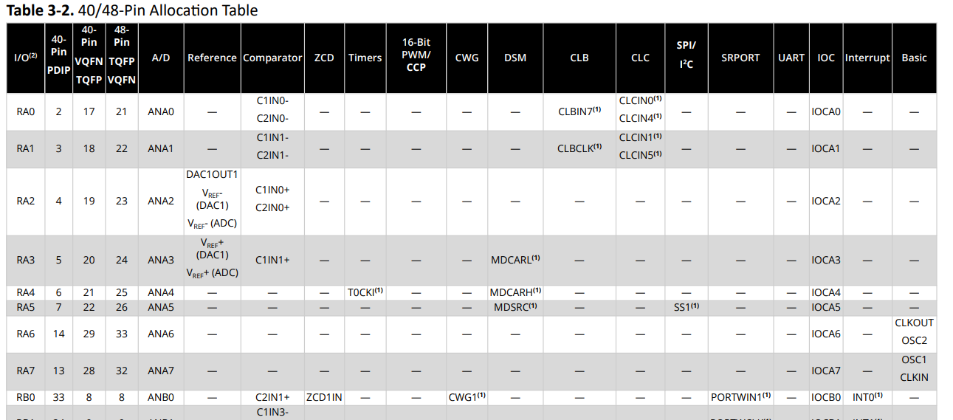
Interrupt – INT0

Slide 17
Interrupt Code
……
/* Interrupt-on-change enabled on the INT0 pin for a negative-going edge. Associated Status bit
and interrupt flag will be set upon detecting an edge. */
INT0EDG = 0
// Setup the handler
On Interrupt ExtInt0 Call InterruptHandler
'Loop forever
Do
LEDD3 = !LEDD3
wait 100 ms
Loop
Sub InterruptHandler
'Toggle the LED
LEDD2 = !LEDD2
End Sub

Slide 18
Lab
Walk the example
View the scope

Slide 20
Videos...
Install the hardware and make the board work – three LED programs
Make four LEDs flash in a sequence
Set the LEDs to represent the value of ADC
Sequence the LEDs with a delay using the value of ADC
Using an input to set the state of the LEDs
Using the reset switch
Using the switch, ADC – make the LEDs flash in a sequence with reverse
Using the serial to display values
Using the timer0 overflow, 8bit timer, 16bit timer to flash the LEDs
Using EEProm – showing values on the serial terminal, and more constants insights
Using I2C with serial to discover I2C devices
Using I2C GCLD display solutions
Using a SPI GLCD display solutions
Using PWM, 6 ways, to dim the LEDS
Using Millis and Interrupts
Using storage within the chip – Progmem, SAF memory, EEPROM and DATA blocks
Using CLC
The GCBASIC tool chain
Assembly , alternatives assemblers and MPLAB-X
Summary

Slide 21
GCBASIC
PIC18FxxQ35chip Family
Part 15 – Millis and Interrupts

